Slide 1
University Life Supervision Panel
Sponsored by
University Life & Friends Supervision Collective
GEORGE MASON UNIVERSITY

Slide 2
UL & Friends Supervision Collective Committee
Rebecca Stauffacher, New Student & Family Programs
Jeff Fichter, Admissions
David Gaskins, Mason Recreation
Meeghan Milette, Housing & Residence Life
Kelly Reid, Student Centers
Krisztina Roder, Student Centers
Jodi Ross, Mason Care Network
Rita Snyder Furr, ADVANCE
Morgan Strimel, Disability Services
Trasi Watson, University Career Services

Slide 3
2019 Supervision Survey
Quick glance…
Over 130 Respondents
Majority: Asst. & Assoc. Directors
Most have received ALL supervision experience at GMU
57% supervise Student Wage Employees
10% of these supervise OVER 25 student staff
Supervisors with Student Wage Employees
50% meet weekly in a structured format
Others meet either monthly or once per semester

Slide 4
2019 Supervision Survey
Supervision Resources & Tools
91% of supervisors of Full-Time staff hold weekly 1:1 meetings
Majority of respondents utilize performance management tools for:
HR annual evaluations
Personal development plans
Reward and recognition programs
Respondents cited team building, professional development, and crucial conversations with employees, as areas for further development as supervisors.

Slide 5
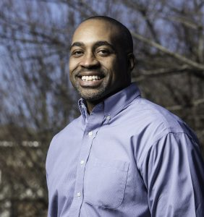
Lewis Forrest - Facilitator
Lewis E. Forrest II, is currently an Associate Dean for University Life at George Mason University. University Life supports every student at Mason, from orientation through graduation. It prepares Mason students for the demands of work, social responsibility, and life in an ever-changing global society. Within University Life, Lewis supervises three units and serves on several campus wide committees and initiatives. Many of the initiatives are specific to Well-Being and student engagement.
He was previously the Executive Director of Mason’s Early Identification Program. He is an Alum of Mason (1996) receiving his Bachelor of Arts degree in English with a minor in African-American Studies. In 2005 he received his Master’s degree in Counseling and Development and was recognized by the College of Education and Human Development for outstanding achievement and academic excellence. He also has years of experience as a Professional School Counselor in Prince William County Public Schools.
GEORGE MASON UNIVERSITY

Slide 6
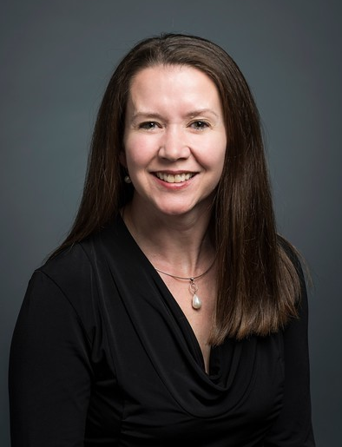
Dr. Rachel Wernicke – Associate Dean
Dr. Rachel Wernicke is a licensed clinical psychologist, currently serving as Associate Dean and Chief Mental Health Officer in University Life where she leads mental health-related initiatives and provides leadership oversight to three units: Counseling and Psychological Services, Student Health Services, and Disability Services. Most recently, she served as Executive Director in Counseling and Psychological Services at George Mason. She completed her doctoral degree in psychology at American University and her doctoral internship and postdoctoral fellowship at Massachusetts General Hospital/Harvard Medical School. Dr. Wernicke’s areas of expertise include college student mental health, anxiety disorders, and trauma.
At Mason, she is working on several initiatives, including engaging the Mason community in a public health approach to suicide prevention in partnership with the Jed Foundation and increasing access to mental health services to under-served students. Rachel has been a supervisor for more than 25 years. She has supervised soldiers, non-commissioned officers, and commissioned officers when she served in the Army. She has also supervised graduate student therapists, masters and doctoral level therapists, psychiatry residents and psychiatrists, administrative staff, full and part-time faculty and staff, and leaders at different levels.
GEORGE MASON UNIVERSITY

Slide 7
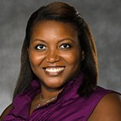
Dr. Adrienne Thompson - Director
Dr. Adrienne Thompson is currently the Director of the Mason Care Network at George Mason University. Dr. Thompson is responsible for implementing Mason’s new success coaching program in collaboration with the major advisors at the institution that is geared toward increasing student success and retention of the undergraduate student population at the institution. Dr. Thompson also works with incoming freshmen, transfer students, and students at-risk of leaving the institution to help with their transition to Mason and provide support to help students be successful at the institution. Dr. Thompson is passionate about helping students be successful during their time in higher education.
She received her Bachelor’s degree in Audiology from the University of Tennessee, her Master’s degree in Higher Education and Student Affairs from Indiana University – Bloomington, and her Ph.D. in Education, specializing in higher education from Mason. Dr. Thompson has been a supervisor for almost 10 years, supervising undergraduates, graduate students, paraprofessional, and professional staff.
GEORGE MASON UNIVERSITY

Slide 8
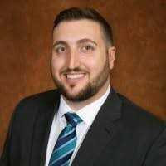
Josh Kinchen – Associate Director
Josh Kinchen joined the ODIME team in February of 2018. He serves as Associate Director for LGBTQ Resources. Within this role, he supervises the team in LGBTQ Resources office and also provides guidance on training development in ODIME and LGBTQ Resources. He previously worked as the Student Program Coordinator in Student Government Association, working with the Allies & Safe Zones program, the Pride Student Union, Congress of Graduate Students, and other initiatives, at Florida State University.
Prior to his career in higher education, Josh served in the United States Marine Corps. Due to this experience, his Master’s thesis was focused on the experiences of LGB military veterans in their undergraduate college experience. This research is soon to be published, to help inform the intersections of support for LGBTQ students, military veterans, and LGBTQ military veterans on college campuses. Mr. Kinchen hails from Slidell, LA, which is in the greater New Orleans area. Josh holds an associate’s degree in Pre-Sociology from Cape Fear Community, a bachelor’s degree in Communication Studies and a Master’s Degree in Higher Education from the University of North Carolina Wilmington.
GEORGE MASON UNIVERSITY

Slide 9
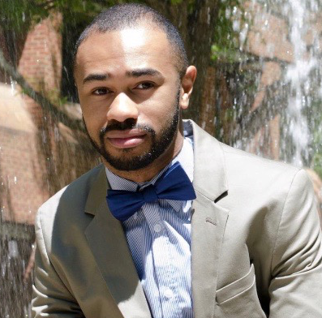
Chris Williams – Assistant Director
Chris Williams was born and raised in a small town outside of Richmond and currently resides in Falls Church, VA. He received his Bachelor's degree in Communication from Mason in 2015 and most recently received his Master of Arts in Higher Education from Mason this summer.
Chris has been working with the Mason Autism Support Initiative in Disability Services since its pilot year in 2014. He became Program Coordinator in 2016 and most recently transitioned into the role of Assistant Director this summer. Chris has been a supervisor of undergraduate peer mentors for 5 years.
GEORGE MASON UNIVERSITY

Slide 10
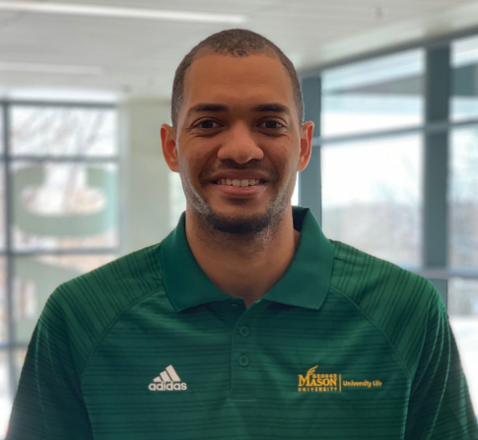
Jalen Howard – Coordinator
Jalen Howard is from a small town in Florida and attended Florida Southern College, where he received a Bachelors in Environmental Studies. After three years of working with the intramural department at FSC, Jalen then attended East Tennessee State University as the Graduate Assistant for Sport Programs before coming to George Mason.
Jalen loves watching his favorite sport teams the Houston Astros, Tampa Bay Buccaneers, and Orlando Magic. In addition to watching sports Jalen enjoys officiating basketball, hiking, cooking, and watching television. Jalen currently supervises undergraduate students.
GEORGE MASON UNIVERSITY

Slide 11
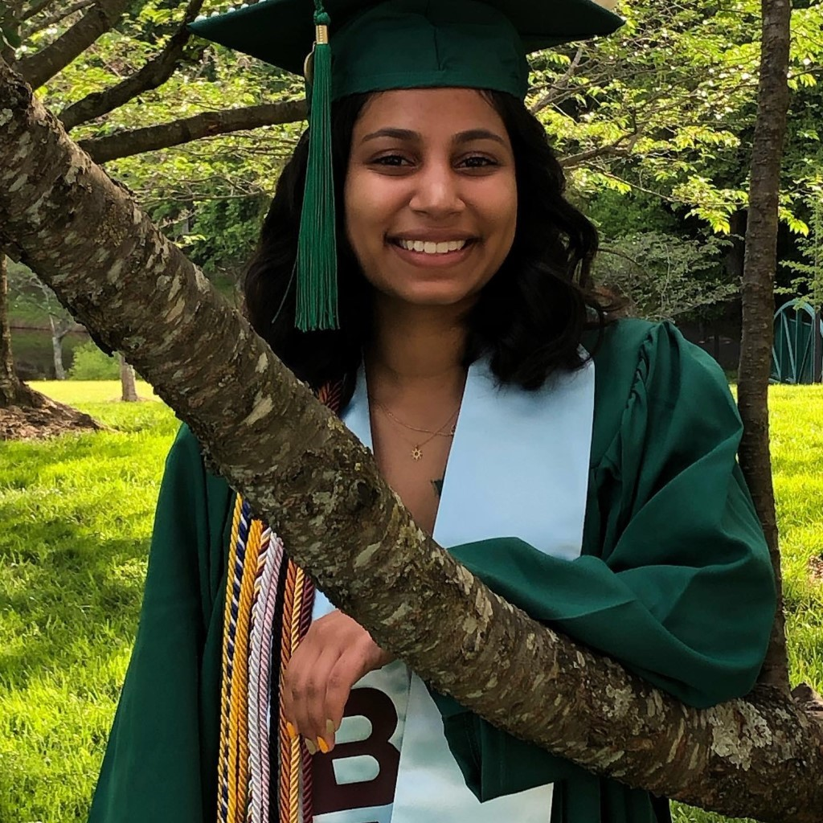
Sasha Toophanie – Graduate Community Director
Sasha Toophanie is a recent Mason Alumni (Spring ‘19) and is now pursuing a M.S. in Criminal Justice while serving as a Graduate Community Director with Housing and Residence Life. She has worked with Housing for three years and co-supervised student staff during her time as a Head Resident Advisor her senior year. Sasha was the first female General Manager of WGMU Radio, a sister in Pi Beta Phi, and a member of Order of Omega, Phi Beta Kappa, and Alpha Lambda Delta.
Sasha has supervised students for 2.5 years prior to her current graduate assistantship. She supervised undergrads through WGMU Radio as Program Director and General Manager She was also Head Resident Advisor of an undergrad student staff in the Mason Global Center and that involved a level of language and cultural barriers between staff and residents. Presently, she supervises undergrad staff in Eastern Shore as a Graduate Community Director.
GEORGE MASON UNIVERSITY

Slide 12
Question #1
What are some thought processes you use to develop your supervisory style?
GEORGE MASON UNIVERSITY

Slide 13
Question #2
As a supervisor, what is one thing you wish you would have known or had the chance to do differently?
GEORGE MASON UNIVERSITY

Slide 14
Question #3
What was the best advice about supervision you were ever given?
GEORGE MASON UNIVERSITY

Slide 15
Question #4
Explain your process for making tough decisions. What factors do you consider, and what are the best ways to manage change for your staff?
GEORGE MASON UNIVERSITY

Slide 16
Question #5
What are the most significant challenges you face as a supervisor?
GEORGE MASON UNIVERSITY

Slide 17
Question #6
How have you approached staffing changes or shortages, and what do you consider related to the impact on your team?
GEORGE MASON UNIVERSITY

Slide 18
Question #7
How do you foster growth opportunities and professional development for your staff?
GEORGE MASON UNIVERSITY

Slide 19
Question #8
Can you share any supervisory training you have participated in? How has it impacted your supervisory style?
GEORGE MASON UNIVERSITY

Slide 20
Question #9
How do you promote well-being and work-life balance among your staff?
GEORGE MASON UNIVERSITY

Slide 21
Question #10
What was the biggest supervisory mistake you’ve ever made and what did you learn from it?
GEORGE MASON UNIVERSITY

Slide 22
Question #11
How have you met the challenge of supervising staff who have more experience or been part of the staff longer than you?
GEORGE MASON UNIVERSITY

Slide 23
Question #12
What are you doing to grow your experience as a supervisor?
GEORGE MASON UNIVERSITY

Slide 24
Questions for the panelists?
GEORGE MASON UNIVERSITY

Slide 25
Closing
Thank you to our Panelists & Facilitator!
Want to connect with other supervisors? Join our committee!
Attend an upcoming meeting of the Supervision Collective:
Friday, October 11, 10-11 a.m.
Friday, November 1, 10-11 a.m.
Thursday, November 14, 10-11 a.m.
Friday, December 6, 10-11 a.m.
All meetings take place in New Student & Family Programs Conference Room, Hub 2500
GEORGE MASON UNIVERSITY

