Slide 1
Radical candor 101
Radical chats
Professional Development Series
Fall 2023

Slide 2
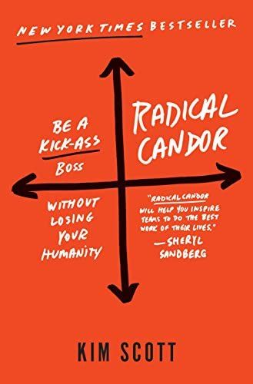
Radical candor by: Kim Scott
CONTENT OVERVIEW:
Radical Candor Overview
Radical Candor In Action
Self-Awareness
Feedback
Staff management
Reflection Activity
Assessment & Upcoming Opportunities
Notes:
Amy

Slide 3
Radical candor 101: learner expectations
RADICAL CANDOR 101
LEARNING OUTCOMES
Engage
Participants will actively engage with the materials provided to learn the foundational concepts of Radical Candor.
Identify
Participants will identify at minimum of 1 action item they can implement to enhance their practice.
Increase
Participants will increase the number of staff management resources they are aware of.
The learning gained from this experience, is dependent on you, the participant. Take time to consider the content and reflect of the concepts presented. Consider work experiences that relate to what is being presented; particularly center you own level of self-awareness with feedback and staff management.
The session is self-paced and we hope you enjoy the learning process!
If you do have any questions or encounter an issue with the materials, please contact ulprodev@gmu.edu.
Notes:
Meeghan

Slide 4
What is radical candor?
Notes:
Meeghan

Slide 5
Kim scott & Radical Candor
Radical Candor is a management and feedback framework, based on the premise that feedback is to be kind, clear, specific, and sincere.
Kim Scott, founder of Candor Inc and author of Radical Candor, has extensive manager experiences working at Apple, Google, & other tech companies.
Notes:
Meeghan

Slide 6
Radical Candor: a visual Primer
Where did it come from? Radical Candor is a concept created by Kim Scott. She wrote a book detailing what it is and how to use within organizations.
.
Radical Candor: Management philosophy, valuing relationships and prioritizing feedback
.
Self-Awareness: Care Personally, Challenge Directly is the core of the framework. Know where you show up in the Candor Quadrants.
.
Staff Management: Relationships are CRITICAL in work and organizational success. Humans are the greatest resource in an organization, and you MUST value the humanity at work. As a manager, show up with your whole self to role model for your team.
.
Feedback Fundamentals: Be Timely, Be Specific, & Provide in Private. This relates to both Praise & Criticism
Notes:
Daylen

Slide 7
Care personally challenge directly
Understand the quadrants
Radical Candor
Getting feedback on your feedback
To be aware of how your feedback lands, you need to ask your staff and colleagues on how you give feedback
Feedback is a gift
With feedback do not get mad, get curious
The more feedback between people on a team, the more success that team is likely to have.
Self-Awareness + Relational Awareness
Providing Feedback AND receiving feedback is an act of bravery and care. It should be treated with value.
Manipulative Insincerity
Obnoxious Agression
Ruinous Empathy
View indepth content on the Radical Candor One-Pager linked in the participant guide
Notes:
Daylen

Slide 8
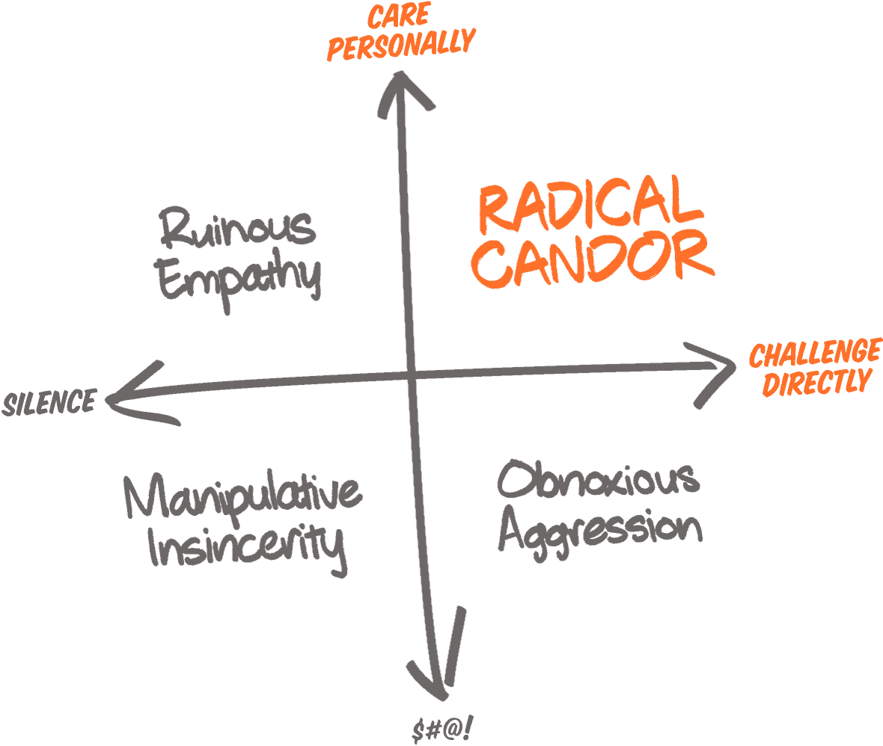
Let's now chat....
Ruinous Empathy: Ignorance; no change
Manipulative Insincerity: Mistrust; no change
Obnoxious Aggression: Defensiveness; Little Change
Radical Candor: Growth; profound change
Notes:
Daylen

Slide 9
Reflecting on feedback
Giving Feedback:
How do you give Feedback to others?
Consider how your delivery may change depending on the individual.
What challenges You when providing feedback to others?
Receiving Feedback:
How do you like to receive feedback?
What is your initial response when receiving feedback?
Consider your physiological response, along with how you process the information.
Read and reflect on the questions provided on this slide. Note your responses for your personal reference.
Notes:
Meeghan

Slide 10
Radically candid feedback
Radical Candor is measured at the listener’s ear not the speaker’s mouth AND knowing whether one has been Radically Candid requires not just self-awareness but also relational-awareness and cultural-awareness. To give Radically Candid feedback — to be aware of how our feedback lands — we need feedback on how we give feedback!
.
Being Radically Candid with yourself requires self-awareness.
.
HIP Approach to Feedback
Criticism side of things
Humble & Helpful
In person/ In private
Immediate
(Not about) Personality
Additional HIP information: https://www.radicalcandor.com/blog/a-hip-approach-to-feedback/
FEEDBACK SANDWICH: Avoid at ALL times! It is INEFFECTIVE
What is a feedback sandwich: When you give critical feedback that is immediately sandwiched between praise.
Ex: Positive Performance Comment + CRITICAL FEEDBACK + Positive Performance Comment
Why you shouldn't do this: Because framing feedback matters. The focus of the feedback to the receiver is on the positive and not the critical feedback. The impact and value are LOST.
Additional Information: https://www.radicalcandor.com/podcast/s5-ep15-avoid-the-feedback-sandwich/
Notes:
MEEGHAN
Humble: It is important to walk into a feedback conversation with a sense of humility, knowing that your point of view is an important piece of a larger puzzle. Speak from your point of view, but leave space for them as well.
Helpful: Consider the goal of the conversation. Are you having it to win, or are you having it to help? Make sure your goal is to help the other person succeed, otherwise it’s not helpful.
Immediate: Give feedback immediately, or as close to immediately as possible. When you wait too long, you can get caught up in debating details versus immediately nipping something in the bud.
In Person or On Video: If you have feedback conversations over the phone or email, you lose much if not all of your ability to get a sense of how your words are landing, as well as an opportunity to hear the full extent of the other person’s experience.
In Private: The part of your brain that interprets physical threats is the same part that activates when you feel a threat to your identity or ego. If you criticize someone in public, chances are they will go into fight, flight, freeze mode and be unable to take in what we are saying.
Not About Personality: Make sure to focus on the behavior, not the person. For example, would you respond better to someone giving you feedback about the need to show up to work on time, or would you prefer that they give you the feedback by calling you lazy?

Slide 11
Candor gauge worksheet
Purpose: Exploring your self-awareness. Let's focus on how you can receive feedback Regarding how you provide feedback to others.
Based on a radical candor tool, the Candor Gauge is a guide for how you can seek out this information from your team and colleagues.
Notes:
https://kimmalonescott.medium.com/thoughts-on-self-awareness-and-the-candor-gauge-7e46289e6de7
Handout needs to be developed MMM

Slide 12
Staff management
Notes:
Daylen

Slide 13
Practices to build
Relationships are the core of supervision. To build stronger relationships with your team, we have compiled resources to support you in this work.
Manager Resources:
Supervision Questionnaire:
In starting any supervisory relationship, it is helpful to know the preferences and expectations of the supervisee and the supervisor. The Supervision Questionnaire provides a variety of questions for an individual to answer.
Can be completed by both the supervisor and supervisee and shared. Should be discussed to receive clarification and understanding. Ask questions to build the relationship.
Link provided in the participant guide.
5-15 forms
Project management tool to better understand the work and priorities being accomplished by members of your team
It should take 5 minutes to reads (Manager) and no more than 15 minutes to write (Staff Member)
Link provided in participant guide
Peer-to-peer feedback encouragement
Build a culture of providing feedback on the team. This could be done in the form of shoutouts notes during a meeting, use of praise in MS Teams, or individual follow up.
As a leader, you set the tone for this cultural development
Expectation setting on the team:
Important to reset expectations with the onboarding or departure of staff or if there is a significant change in the team's workflow.
Expectations should be a living document with your team to guide the work moving forward
Notes:
Daylen/Meeghan

Slide 14
accountability
Move to Action:
Identify ONE action, skill, or strategy you will try with your team or in your work in the next week.
Email UL Professional Development to allow us to be your accountability partner!
Share with us your action and how it went with the implementation.
Email us at ulprodev@gmu.edu
Notes:
Meeghan

Slide 15
Questions?
If you have any questions, email ULproDev@gmu.edu
Notes:
Daylen/Meeghan

Slide 16
We'd love your feedback!
Assessment link:

Slide 17
UPCOMING RADICAL CHATS PROFESSIONAL DEVELOPMENT OPPORTUNITIES:
Nov. 2023
Upcoming Radical Chats Professional Development Opportunities November 2023
Spring 2024
Radical Chats Cohort Spring 2024
Interested? Contact Meeghan Milette (mharrin8@gmu.edu)
For Radical Chats updates, visit www.ulprofdev.gmu.edu
Notes:
Meeghan

Slide 18
thank you!!!
On the behalf of the radical chats facilitation team, we hope you enjoyed this session!
Please consider joining us for a future
Radical chats session!
Notes:
Daylen/Meeghan

Slide 19
citations
Scott, K. (2023). Radical candor: Be a kick-ass boss without losing your humanity. St. Martin’s Griffin.
Radical Candor Website:
HIP Feedback
Scott, K. (2022). 6 tips for giving helpful feedback. Radical Candor. https://www.radicalcandor.com/blog/tips-for-giving-feedback/#:~:text=The%20best%20feedback%20is%20Radically,%2FPrivate%20criticism%2C%20not%20Personalized.
Feedback Sandwich
Scott, K. (2022b). The feedback sandwich is ineffective: Do this instead. Radical Candor. https://www.radicalcandor.com/blog/feedback-sandwich-praise-criticism/
Scott, K., Rosoff, J., & Sandler, A. (Hosts). "Kiss Me, Kick Me, Kiss Me (The Feedback Sandwich)" Radical Candor Podcast. Season 5, Episode 15.https://www.radicalcandor.com/podcast/s5-ep15-avoid-the-feedback-sandwich/
Candor Gauge
Laraway, R. (2023, September 14). How to gauge your feedback. Radical Candor. https://www.radicalcandor.com/blog/gauge-your-feedback/
Radical Candor Learning Guides
https://www.radicalcandor.com/resources/#learning

